Slide 1
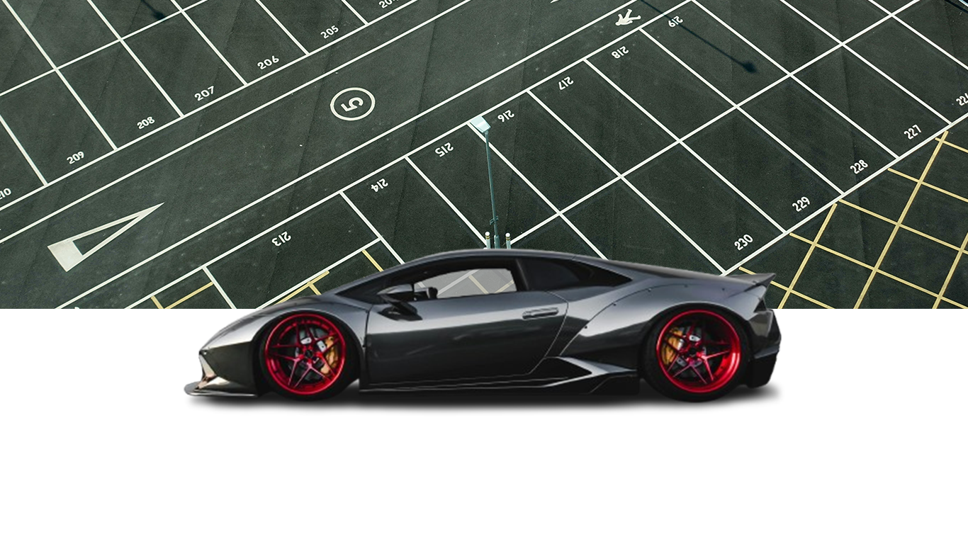
“PARKING MANAGEMENT SYSTEM ~PMS”

Slide 2


Swami Sahajanand College of Computer Science
(Affiliated to: Maharaja Krishnakumarsinhji Bhavnagar University)
Project Presentation on
“PARKING MANAGEMENT SYSTEM ~PMS”

Slide 3
SUBMITTED IN FULFILLMENT FOR AWARD OF DEGREE IN
Bachelor of Computer Application (2024-2025)
Submitted By:
1.Sutariya Jay P
ID: 3142206120220343
2. Mangukiya Prince A
ID: 3122206120220228

Slide 4
INDEX
1
. Introduction
 | 1. Objective (1 Slide)
 | 1. Purpose (1 Slide)
 | 1. Scope (1 Slide)
 | 1. Applicability (1 Slide)
. Requirement And Analysis
 | 1. Problem definition (1 Slide)
 | 1. Hardware Software Requirement. (1 Slide)
. System design
 | 1. DFD / ER / Use Case etc.
 | 1. Data Dictionary
 | 1. Software Screen Shots (As per your project)
. Conclusion
 | 1. Limitation of system (1 Slide)
 | 1. Future Scope of system (1 Slide)
 | 1. Bibliography (1 Slide)
2
3
4

Slide 5
Introduction
A Vehicle Parking Management System is a digital solution to manage and streamline vehicle parking activities efficiently.
The system has two main modules: Admin Side and User Side.
Ensures accurate record-keeping of vehicle entries and exits.
Enhances user experience by allowing users to view and print their parking tickets using their mobile number.
Aims to reduce manual effort, improve security, and enable quick information access through a centralized system.

Slide 6
Objective
The main objective of the Vehicle Parking Management System is to provide an efficient and automated solution for managing parking spaces. The system is designed to streamline the process of vehicle entry and exit, enhance user experience by providing easy ticket printing, and enable administrators to monitor and control parking data effectively. Key objectives include:
To develop a user-friendly system for managing vehicle parking operations efficiently.
To enable real-time recording of vehicle In and Out entries.
To provide automated ticket generation in PDF format for each parking transaction.
To allow Admin to access and manage vehicle and user information via a dashboard.
To let Users view and print their parking tickets using their mobile number.
To enhance transparency, reduce manual errors, and speed up parking processes.

Slide 7
Purpose & Scope
Purpose:
Efficiency: Streamline the parking management process for both admin and users.
Automation: Automate ticket generation, reducing manual errors and time consumption.
User Experience: Allow users to easily access and print parking details, providing greater convenience.
Data Management: Enable accurate record-keeping and quick access to user/vehicle information for admins.
Scope:
Admin Side:
Record vehicle entries and exits in real-time.
Generate PDF parking tickets for users.
Dashboard for overall system status and data visualization.
Search and manage user and vehicle details based on registration and mobile numbers.
User Side:
Retrieve parking information using mobile number.
View and print parking tickets.
Access details like vehicle registration number, owner name, and category.

Slide 8
Problem Definition
Inefficient Parking Space Allocation:
Without automated systems, operators struggle with efficiently assigning parking spaces, leading to overcrowded or underused areas.
Drivers waste time searching for an available spot, reducing overall parking lot efficiency.
Manual Ticketing and Tracking:
Many parking lots still use paper-based methods for generating tickets and recording vehicle entry/exit.
This process is prone to errors, resulting in incorrect charges, lost tickets, and dissatisfied customers.
Long Wait Times:
During peak hours, long queues for ticketing and payment processing cause frustration and delays, negatively impacting the user experience.
Lack of Real-Time Information:
Operators often lack access to real-time data about parking space availability, hindering quick decision-making and optimal space usage.

Slide 9
Hardware Software Requirement
HARDWARE REQUIREMENT
Processor : i3 processor or 1GHz based computer or higher.
Memory : 2 GB RAM And So much more.
Hard Drive Or SSD : 50 GB And So much more
Printer : For Bill Print
User Requirements: Laptop /Computer/Smart Mobile
SOFTWARE REQUIREMENT
Operating system: Windows 7, 8, 10 And Above, Linux, Mac OS 10.5 and above
Local Server: WAMP sever / Xampp server / Apache server.
Editor: Notepad++/Macromedia Dreamweaver 8.
Frontend Tools: PHP, HTML, CSS, Java Script, bootstrap, jquery, Ajax.
Backend tools: My SQL.
Web Browser: Microsoft Internet Explorer / Mozilla Firefox, Google Crome/Opera mini/brave.
Image Edit: Photoshop.

Slide 10
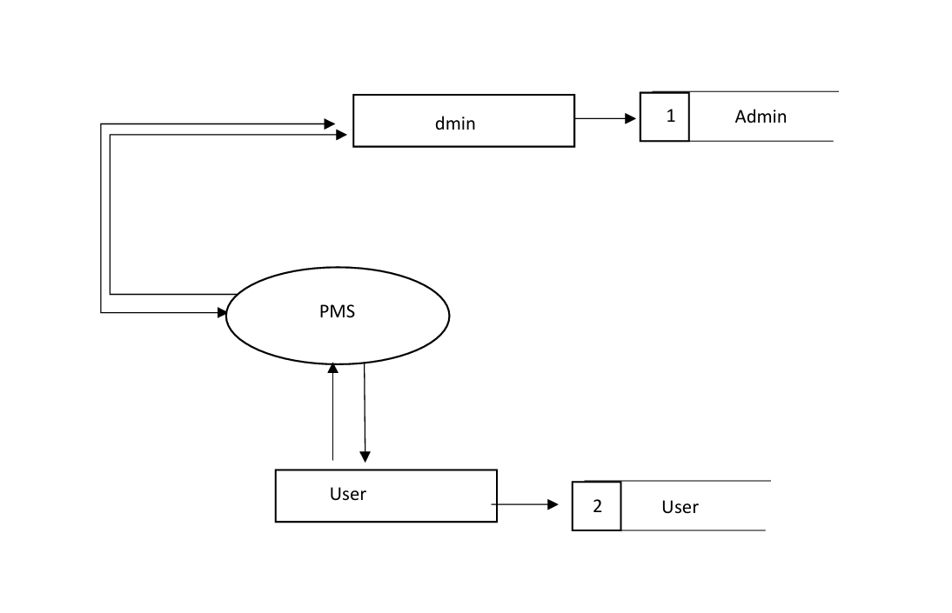
DFD
0 or Context Level DFD
DFD
0 or Context Level DFD

Slide 11
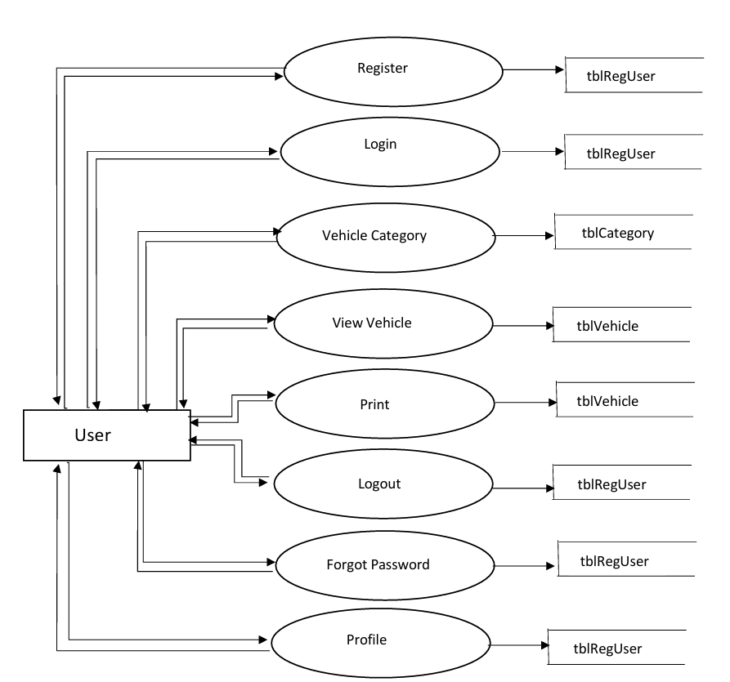
DFD
1 or Context Level DFD
DFD
1st Level DFD
(USER)

Slide 12
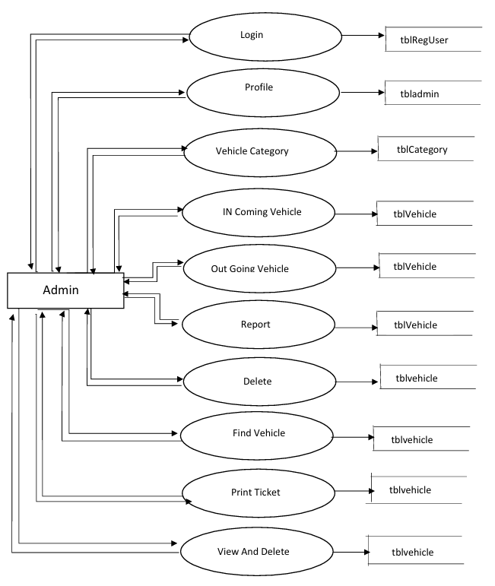
DFD
1st Level DFD
(ADMIN)

Slide 13
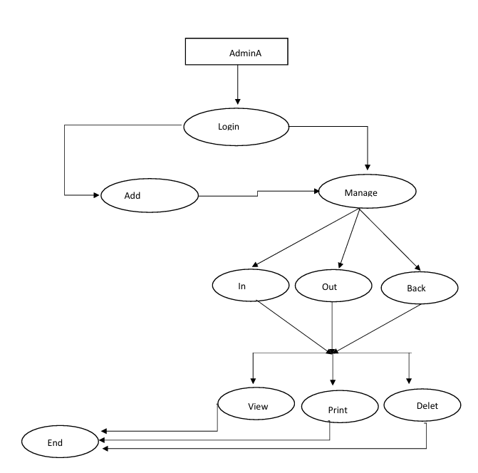
DFD
2nd Level DFD
(ADMIN)

Slide 14
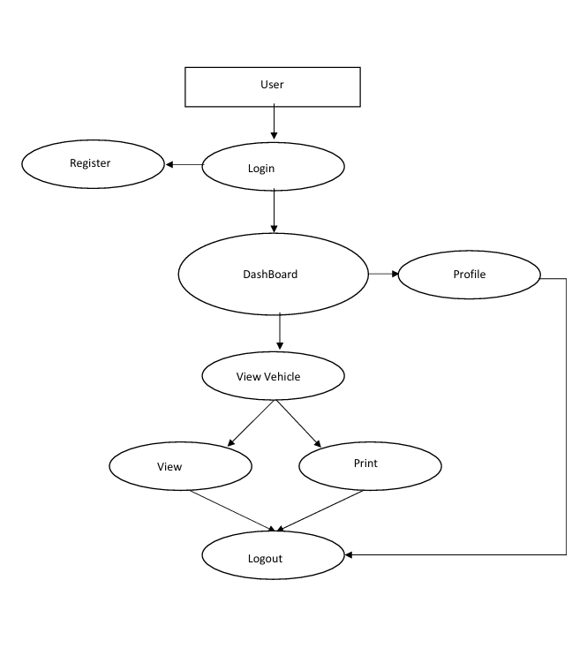
DFD
2nd Level DFD
(USER)

Slide 15
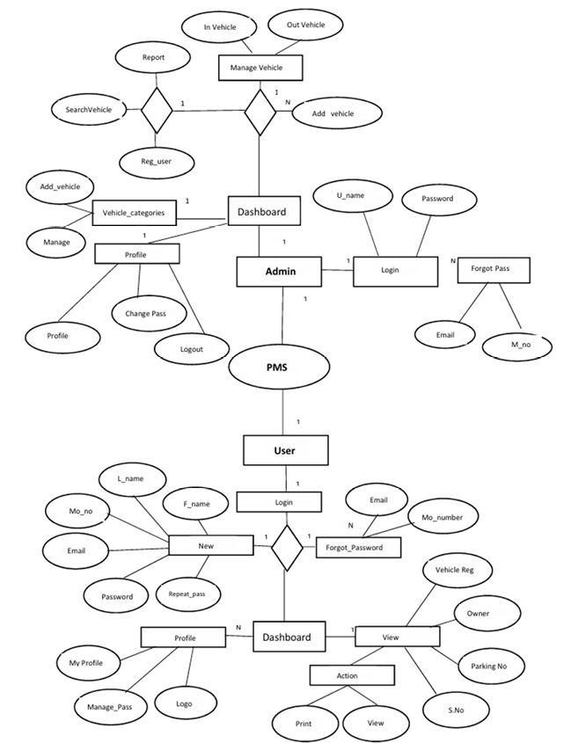
E-R Diagram
Admin Features
Login: Username & Password
Forgot Password: Via Email or Mobile No.
Dashboard Access:
Manage Vehicles (In/Out)
Add/Search Vehicles
Generate Reports
View Registered Users
Manage Vehicle Categories
Profile Options: View/Edit, Change Password, Logout
User Features
Register/Login: Name, Mobile No., Email, Password
Forgot Password: Email or Mobile No.
Dashboard Access:
View Vehicle Info (Reg No., Owner, Parking No.)
Print/View Actions
Profile Options: My Profile, Change Password, Upload Logo

Slide 16
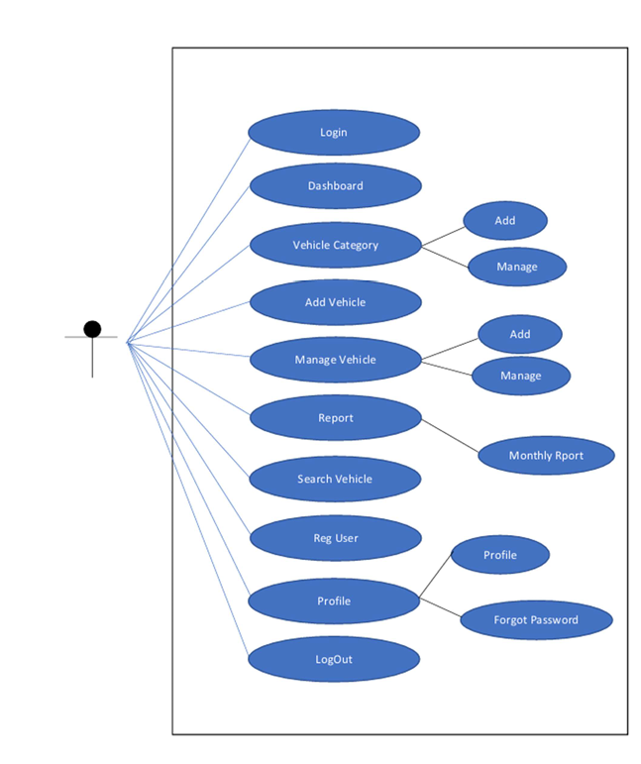
Use Case
DFD
(ADMIN)

Slide 17
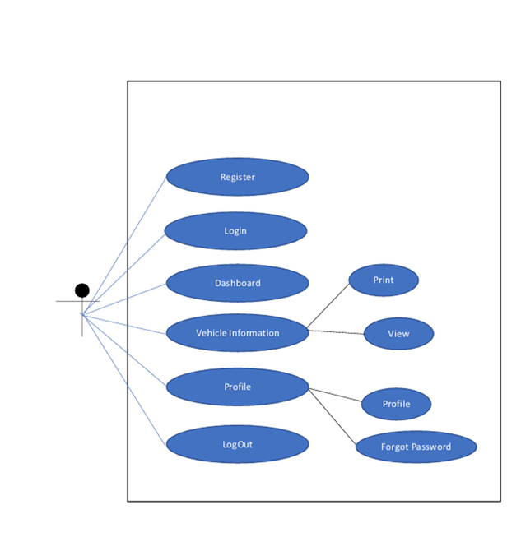
Use Case
DFD
(USER)

Slide 18
Data Dictionary
Database Name:vpmsdb
SR NO | Table Name
1 | Tbladmin
2 | Tblcategory
3 | Tblregusers
4 | tblvehicle

Slide 19
Data Dictionary
Table Name : Table Category
Sr. No. | Field Name | Data type | Size | Constraints
1 | Id | Int | 10 | Primary Key
2 | VehicleCat | varchar | 120 | Foreign Key
3 | CreationDare | timestamp | - | Not Null

Slide 20
Data Dictionary
Table Name : Table User
Sr. No. | Field Name | Data type | Size | Constraints
1 | Id | Int | 5 | Primary Key
2 | FirstName | varchar | 250 | Not Null
3 | LastName | Varchar | 250 | Not Null
4 | MobileNumber | Bigint | 10 | Foreign Key
5 | Email | Varchar | 250 | Not Null
6 | Password | Varchar | 250 | Not Null
7 | RegDate | timestamp | - | Not Null

Slide 21
Data Dictionary
Table Name : Table Admin
Sr. No. | Field Name | Data type | Size | Constraints
1 | Id | Int | 10 | Primary Key
2 | AdminName | varchar | 120 | Not Null
3 | UserName | Varchar | 120 | Not Null
4 | MobileNumber | Bigint | 10 | Not Null
5 | Email | Varchar | 200 | Not Null
6 | Password | Varchar | 120 | Not Null
7 | AdminRegDate | timestamp | - | Not Null

Slide 22
Data Dictionary
Table Name : Table Vehicle
Sr. No. | Field Name | Data type | Size | Constraints
1 | Id | Int | 10 | Primary Key
2 | Parking Number | varchar | 120 | Not Null
3 | VehicleCategory | Varchar | 120 | Not Null
4 | Vehicle Company Name | Varchar | 120 | Not Null
5 | Registration Number | Varchar | 120 | Not Null
6 | Owner Name | Varchar | 120 | Not Null
7 | Owner Contact Number | Bignit | -10 | Not Null
8 | InTime | Timestamp | - | Not Null
9 | OutTime | Timestamp | - | Not Null
10 | ParkingCharges | Varchar | 120 | Not Null
11 | Remark | Mediumtext | - | Not Null
12 | Charges | varchar | 5 | Not Null

Slide 23
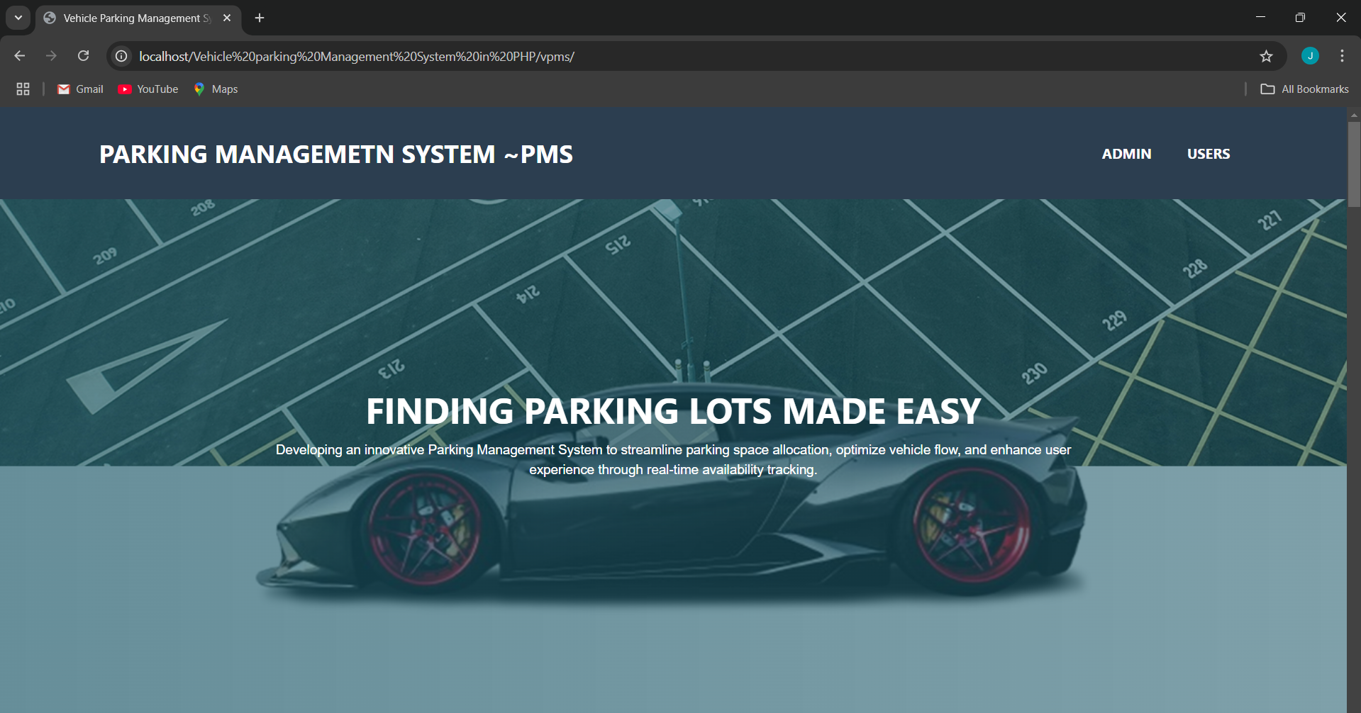
Screen Shot
ScreenShot : Home page

Slide 24
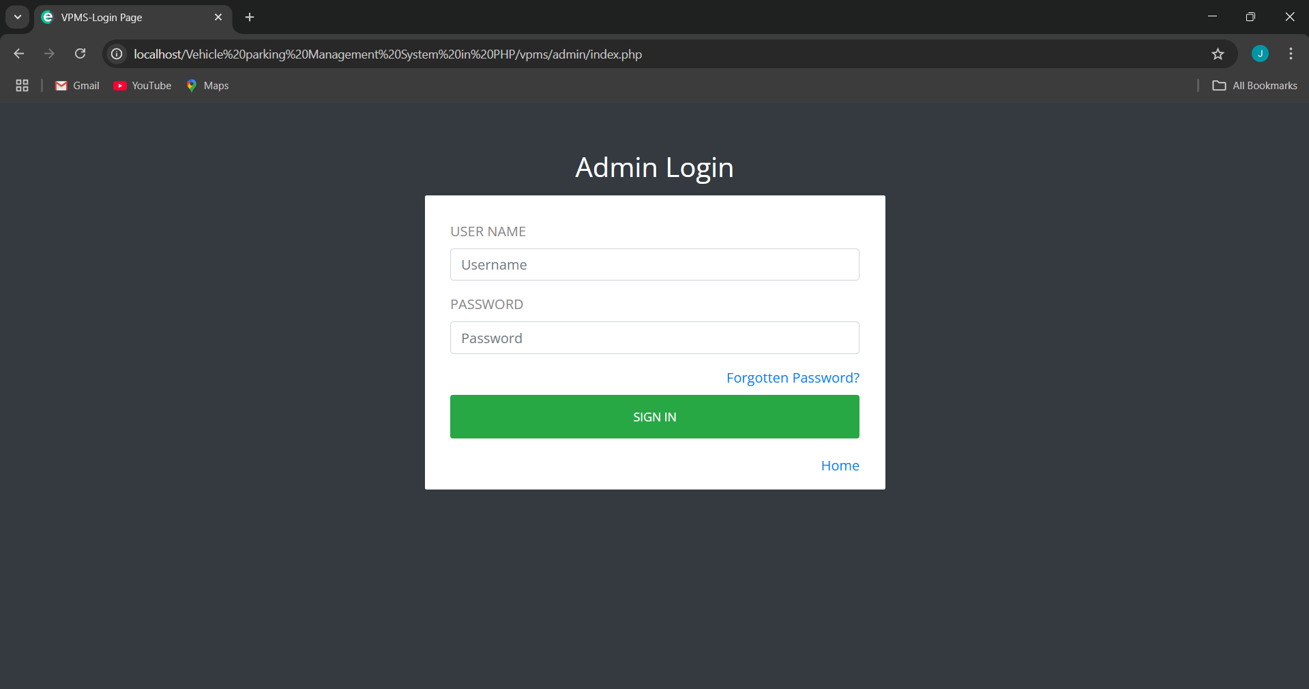
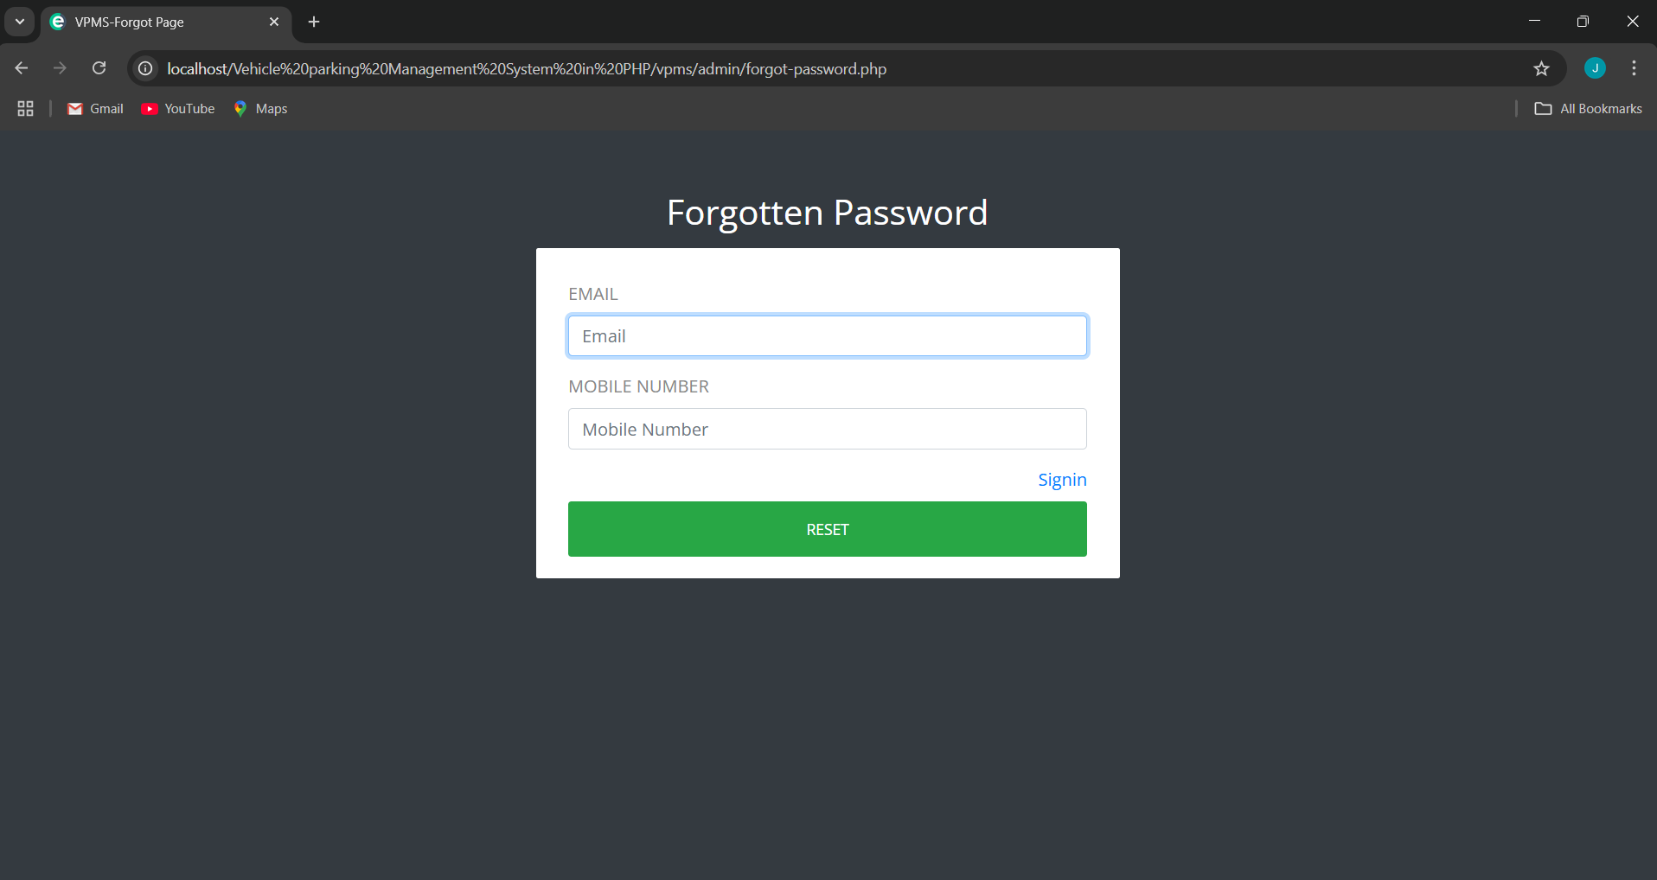
Screen Shot
ScreenShot : Admin
ScreenShot : Login
ScreenShot : Forgot Password

Slide 25
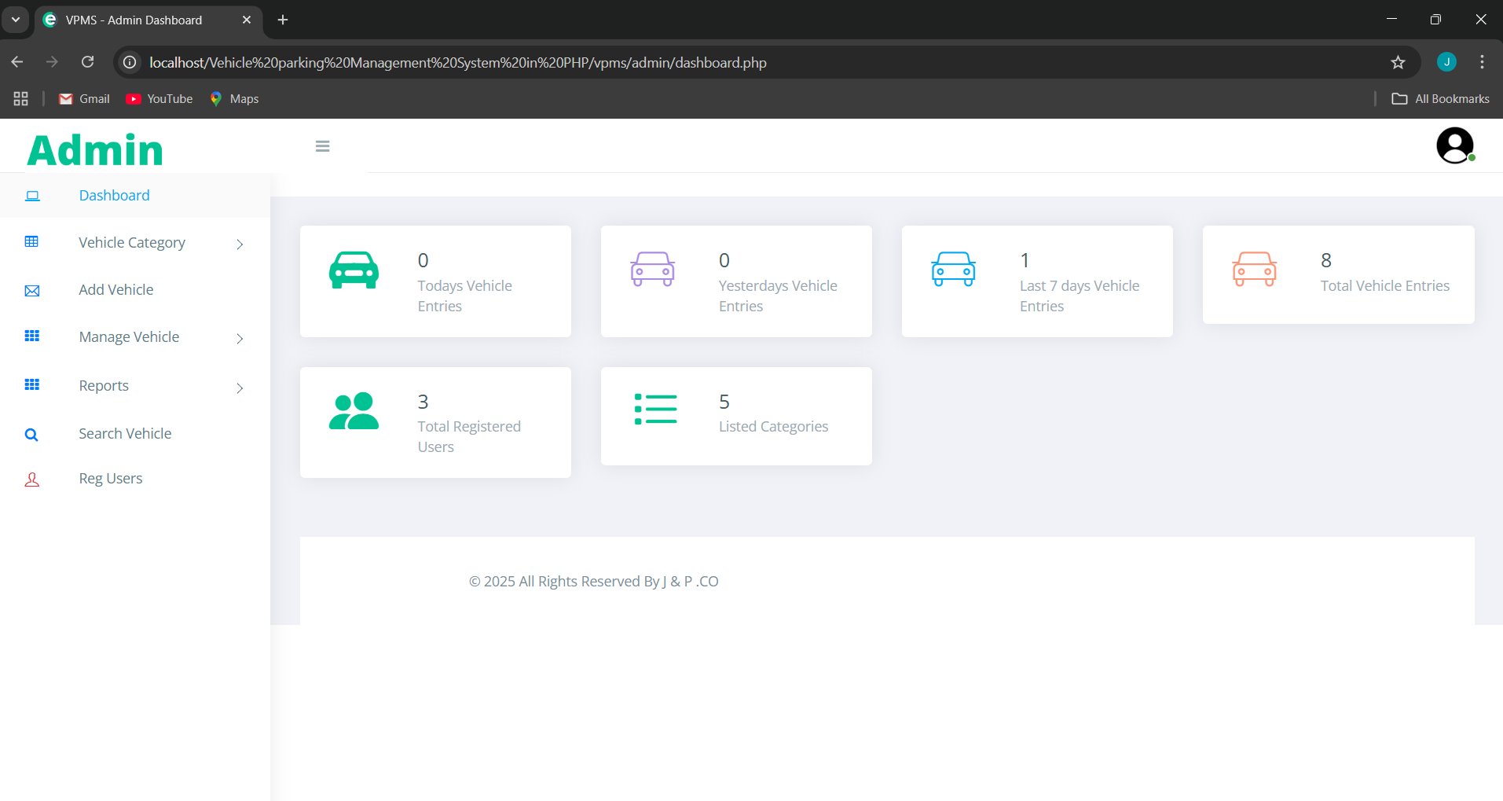
Screen Shot
ScreenShot : Admin DashBoard

Slide 26
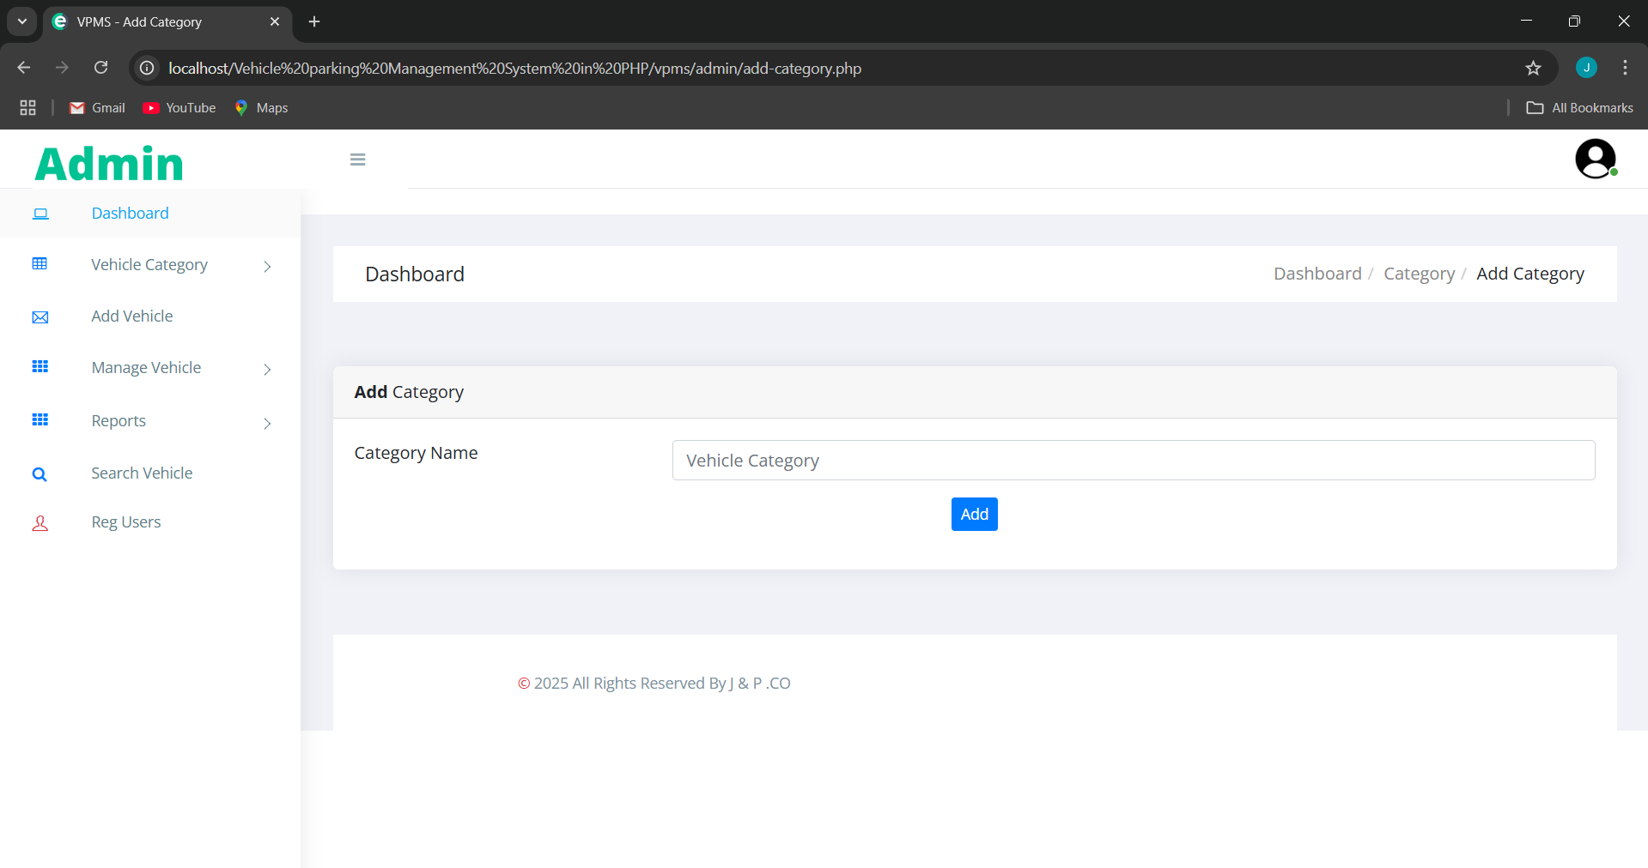
Screen Shot
ScreenShot : Categoris Insert

Slide 27
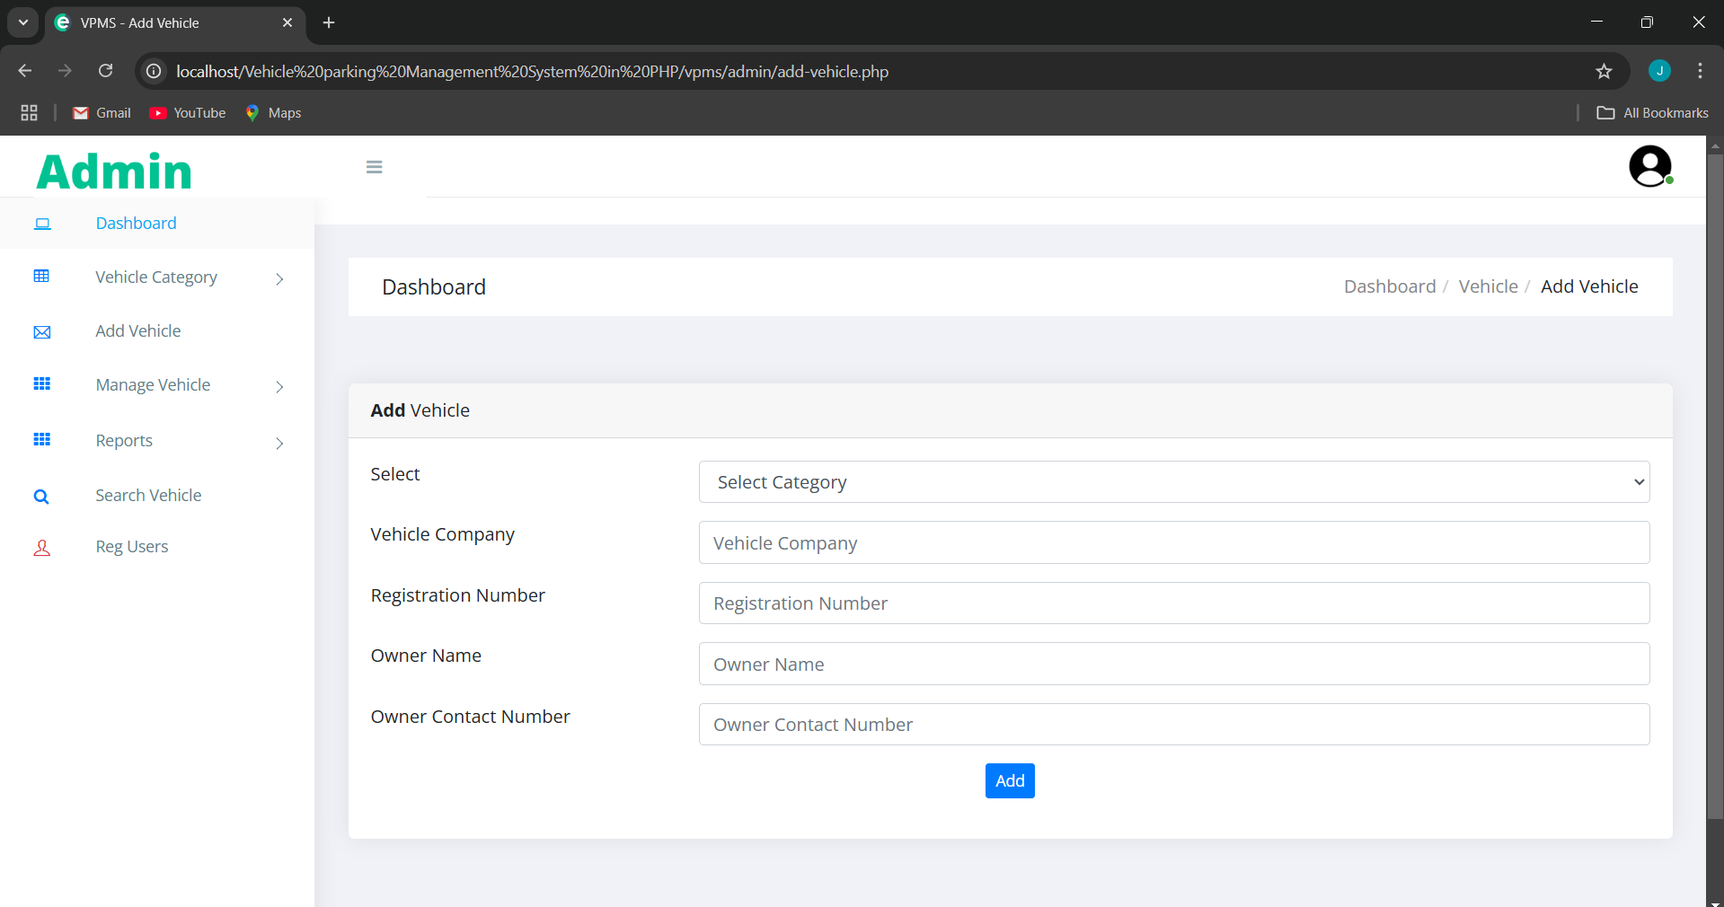
Screen Shot
ScreenShot : Admin Add Vehicle

Slide 28
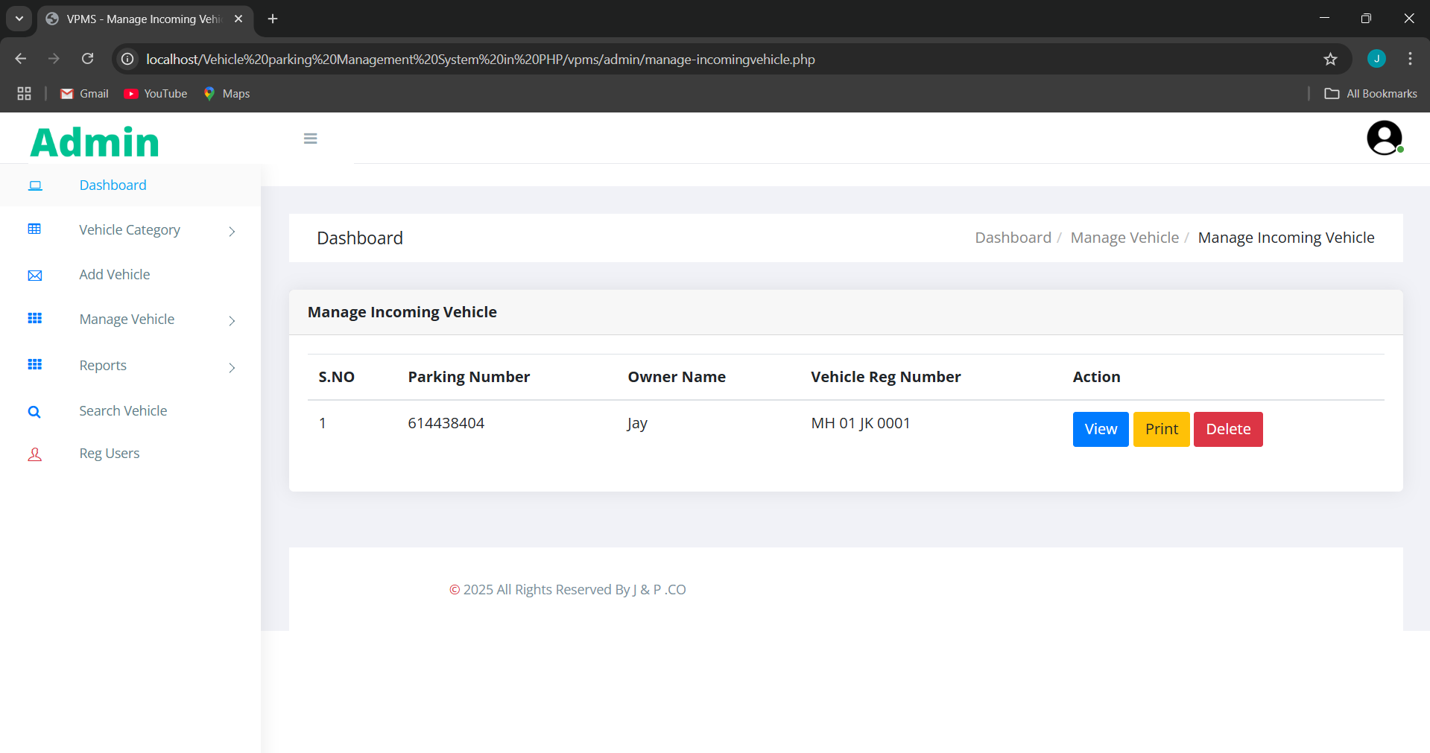
Screen Shot
ScreenShot : Admin Incoming Vehicle

Slide 29
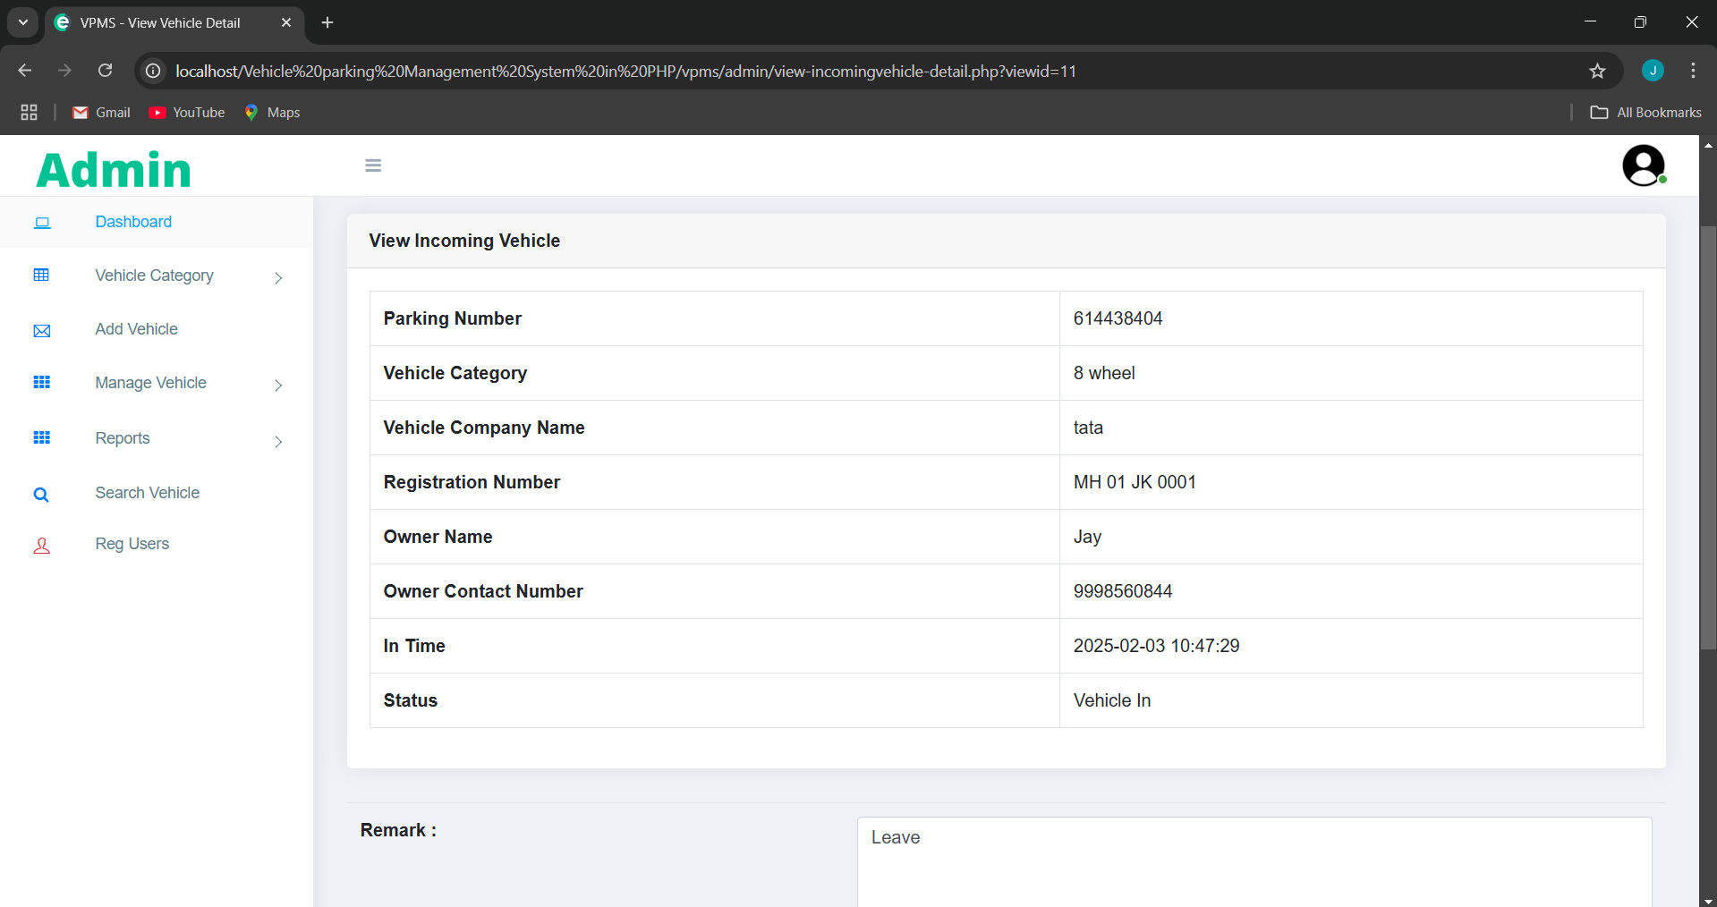
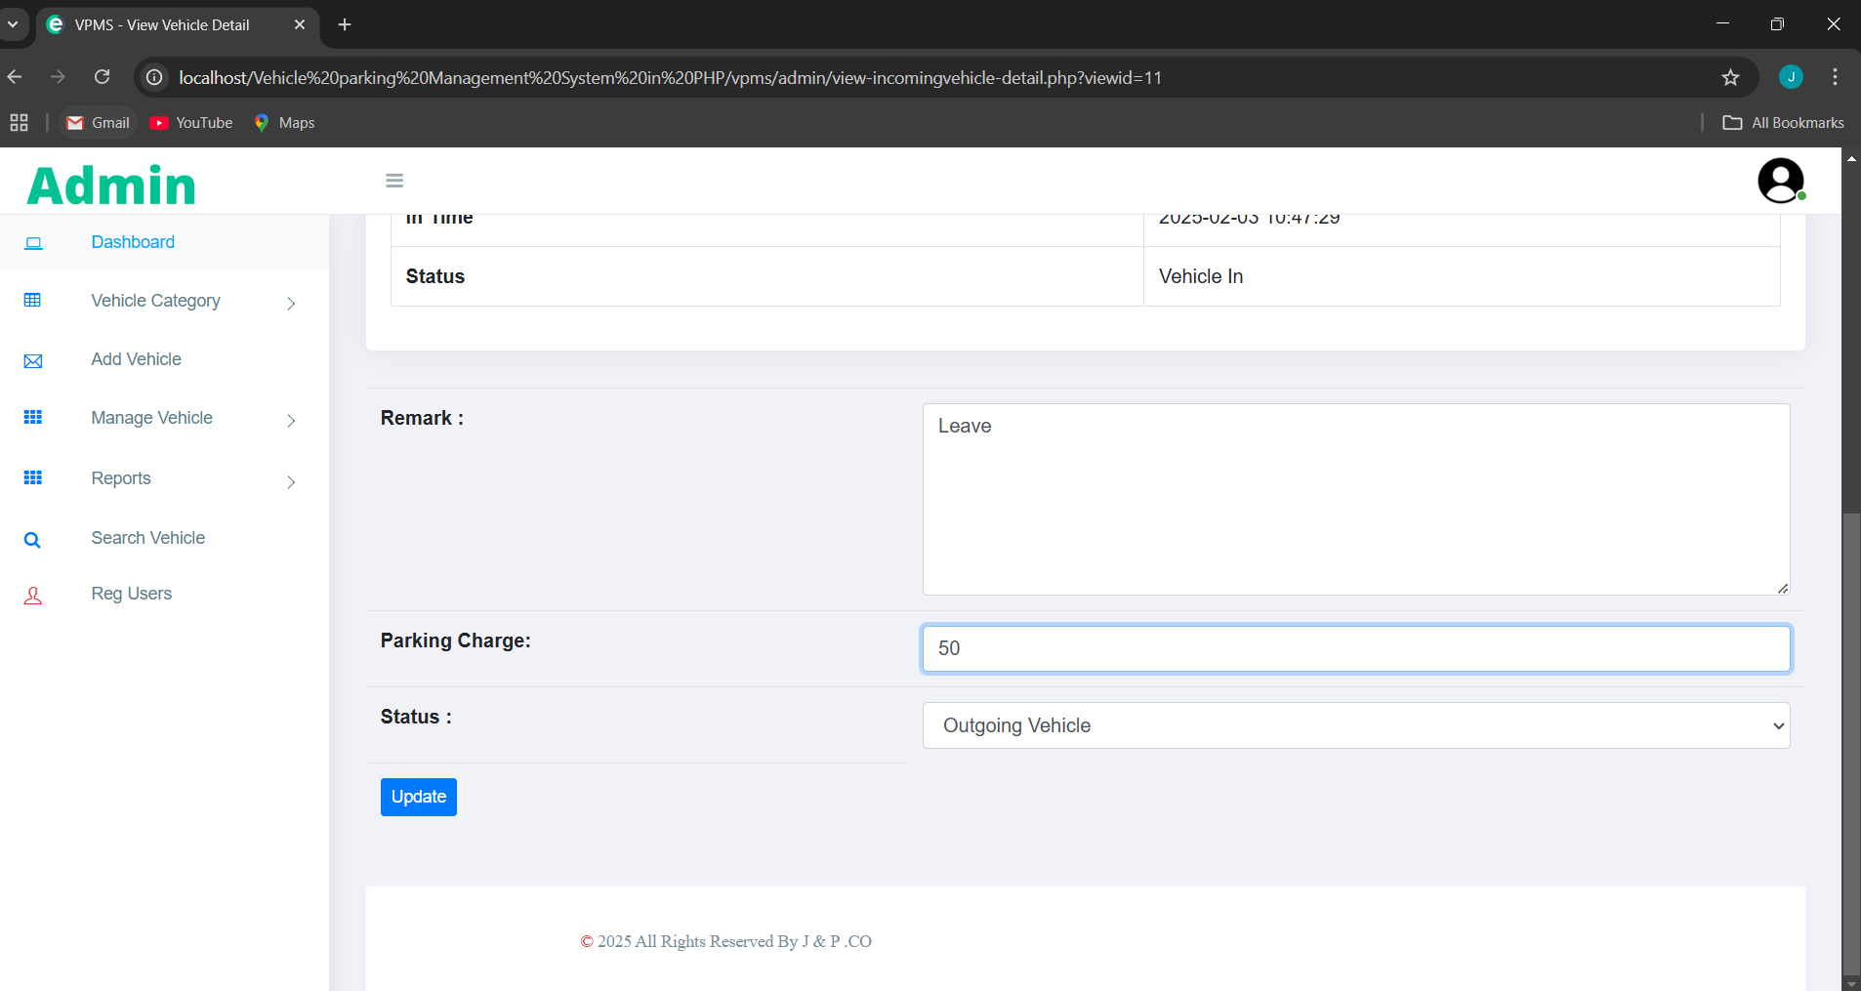
Screen Shot
ScreenShot : Admin Incoming Vehicle View

Slide 30
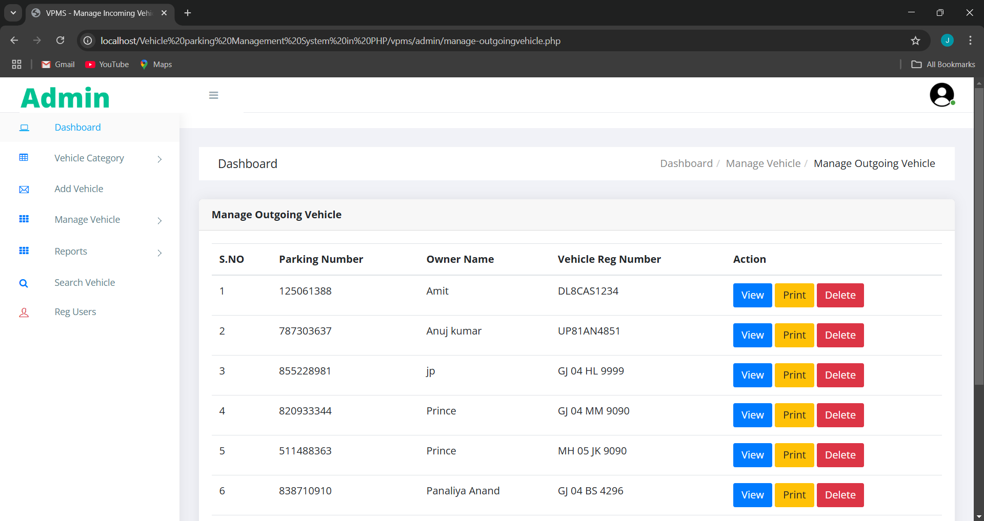
Screen Shot
ScreenShot : Admin OutGoing Vehicle

Slide 31
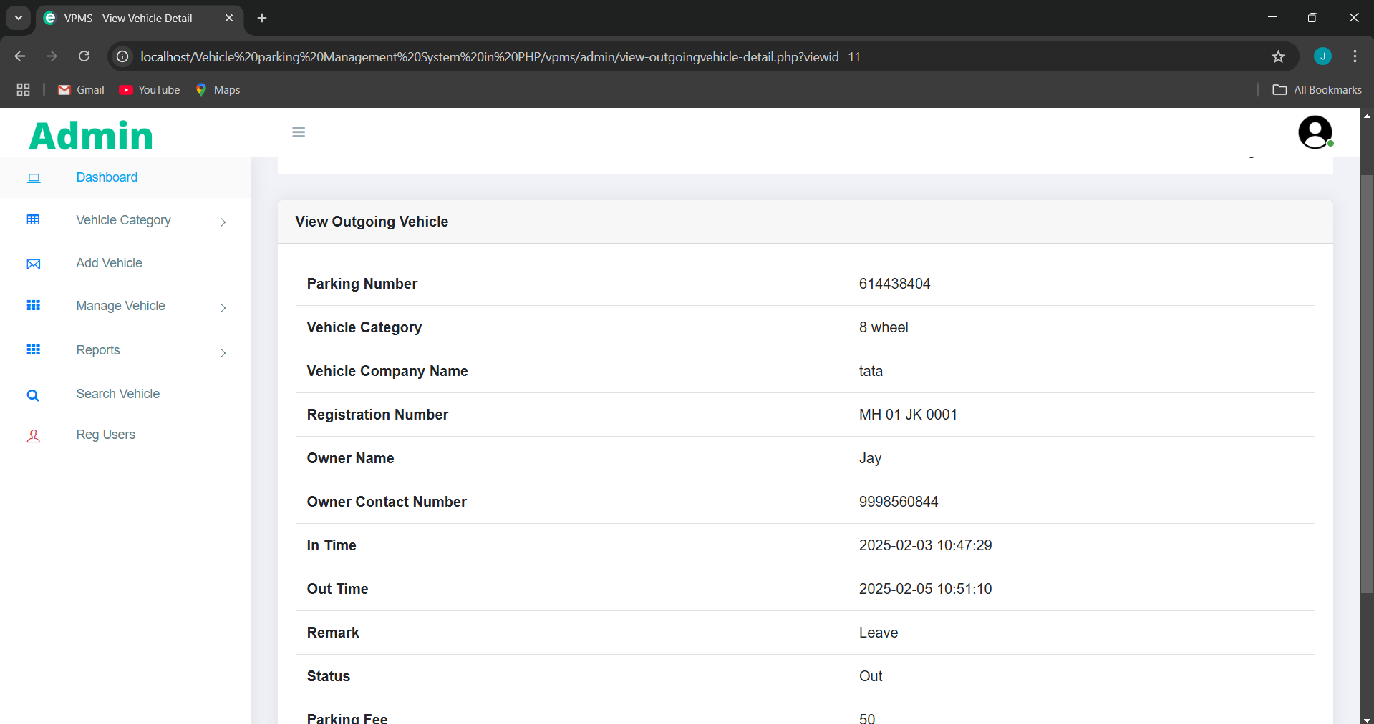
Screen Shot
ScreenShot : Admin Detail OutGoing Vehicle

Slide 32
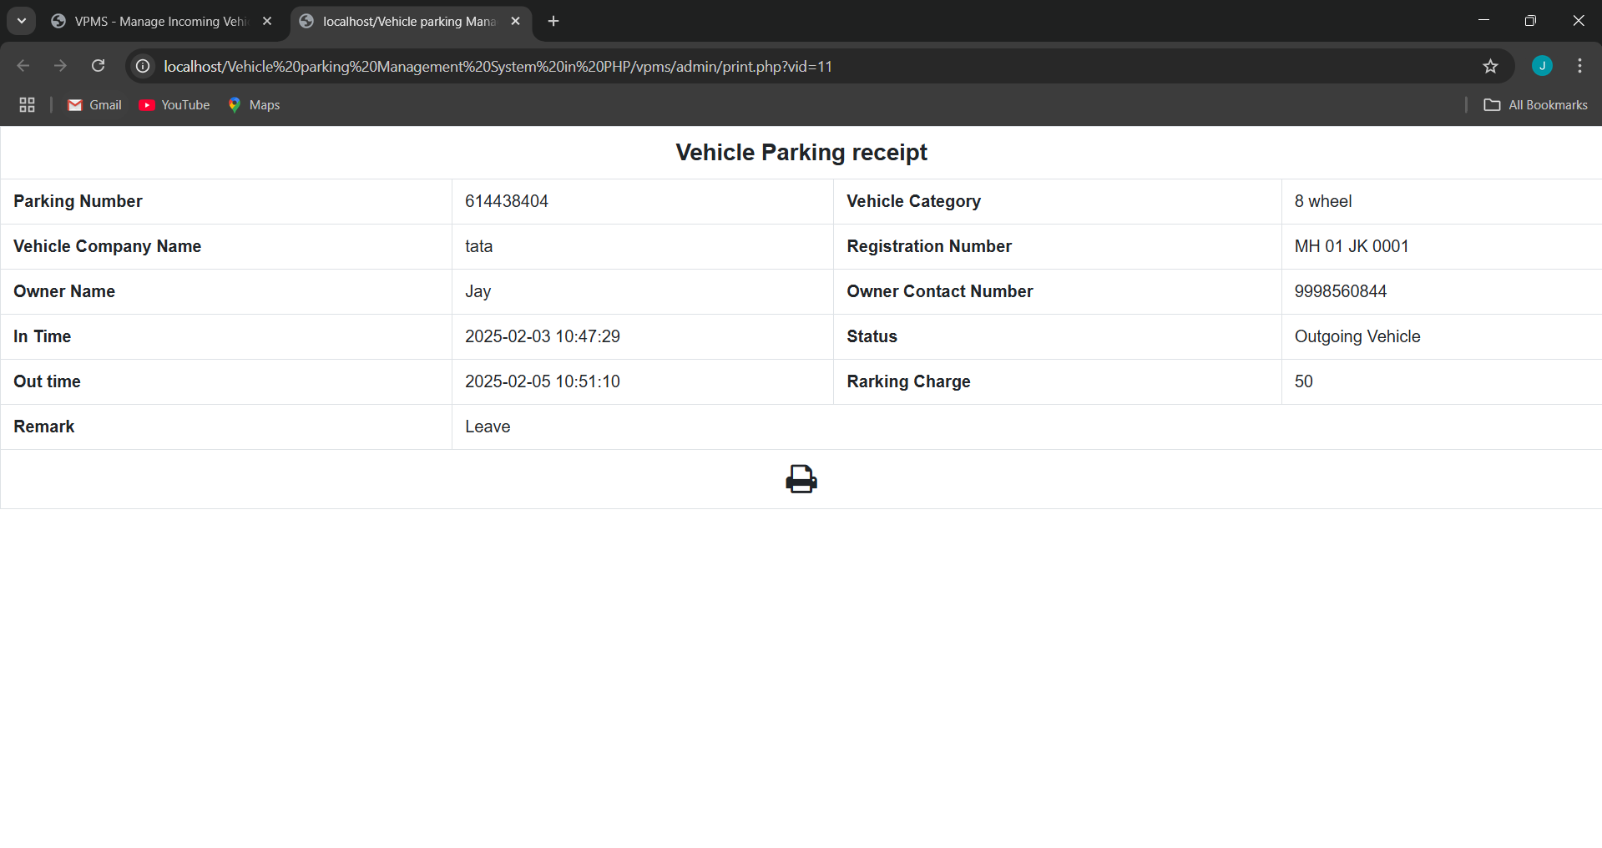
Screen Shot
ScreenShot : Admin Print Ticket

Slide 33
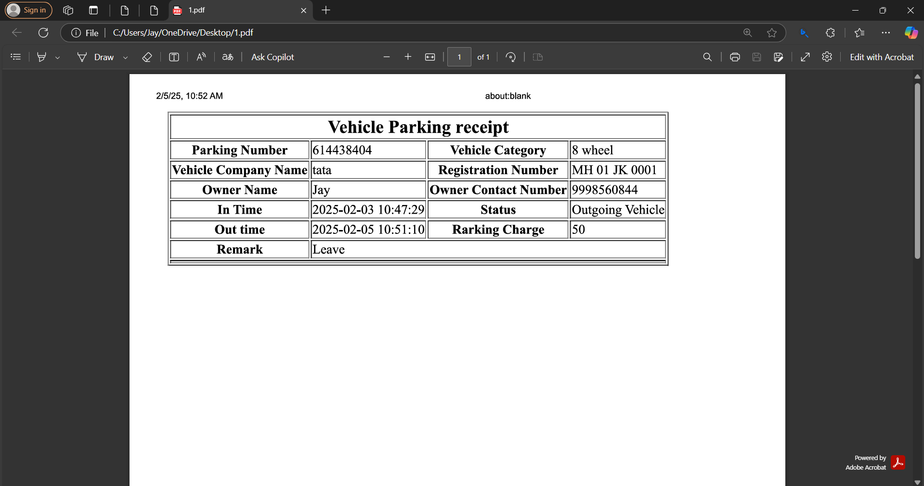
Screen Shot
ScreenShot : Admin PDF format Print Ticket

Slide 34
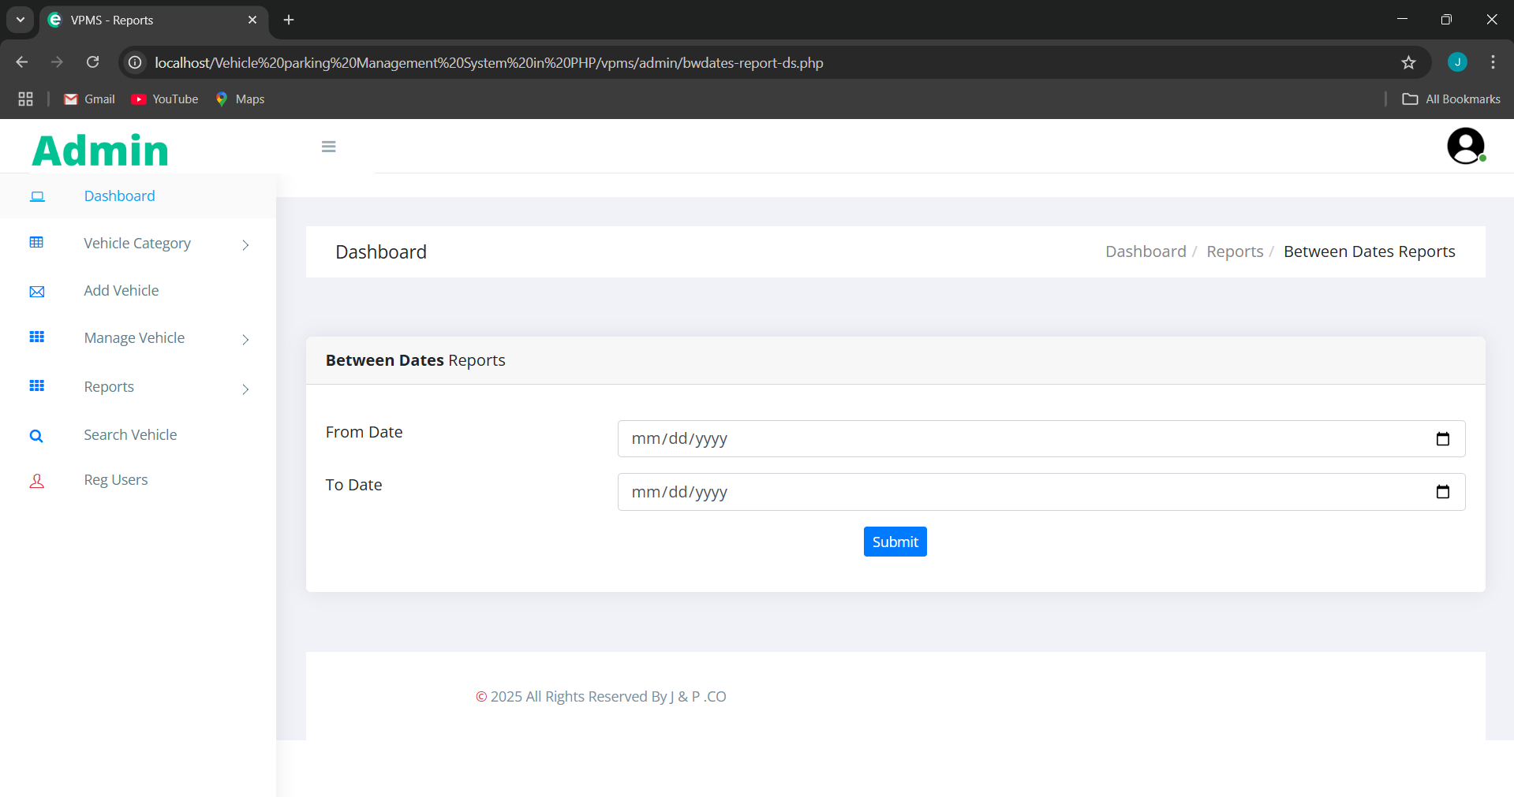
Screen Shot
ScreenShot : Admin Monthly Report

Slide 35
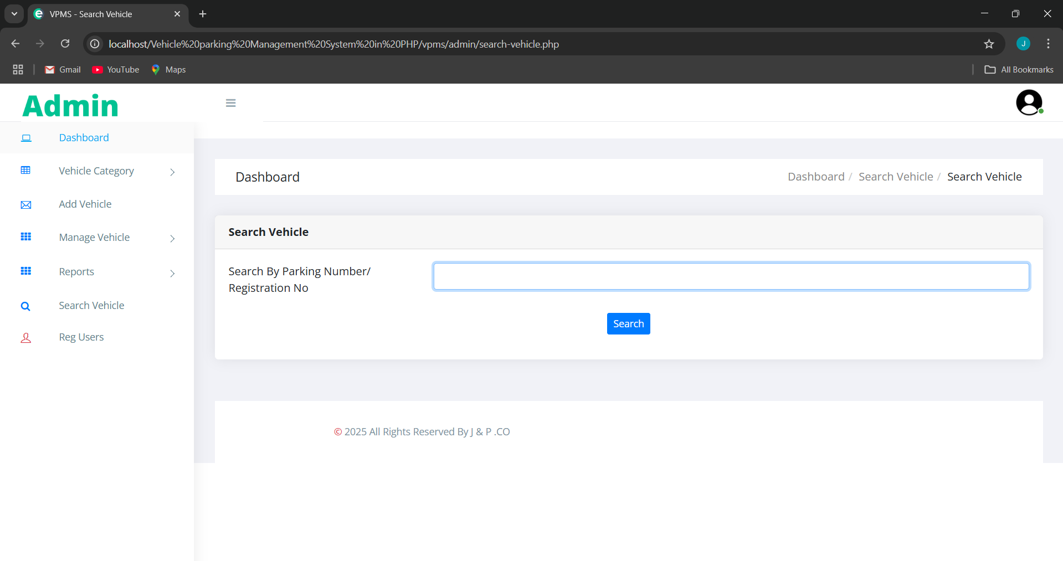
Screen Shot
ScreenShot : Admin Search Vehicle

Slide 36
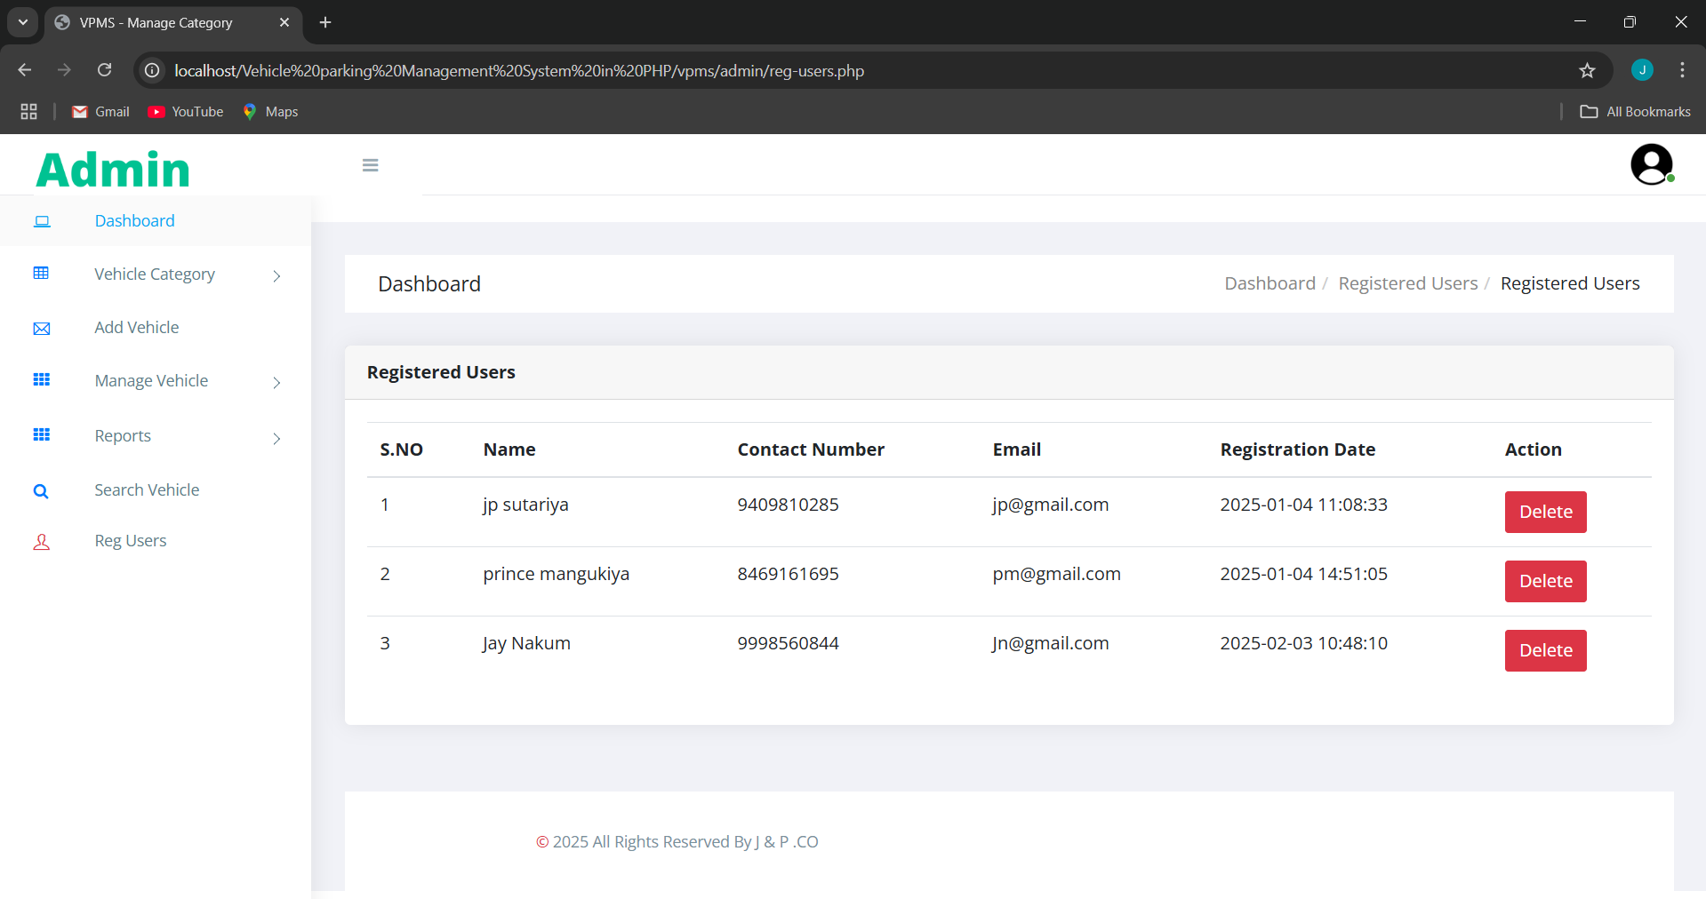
Screen Shot
ScreenShot : Admin See User Login Detail

Slide 37
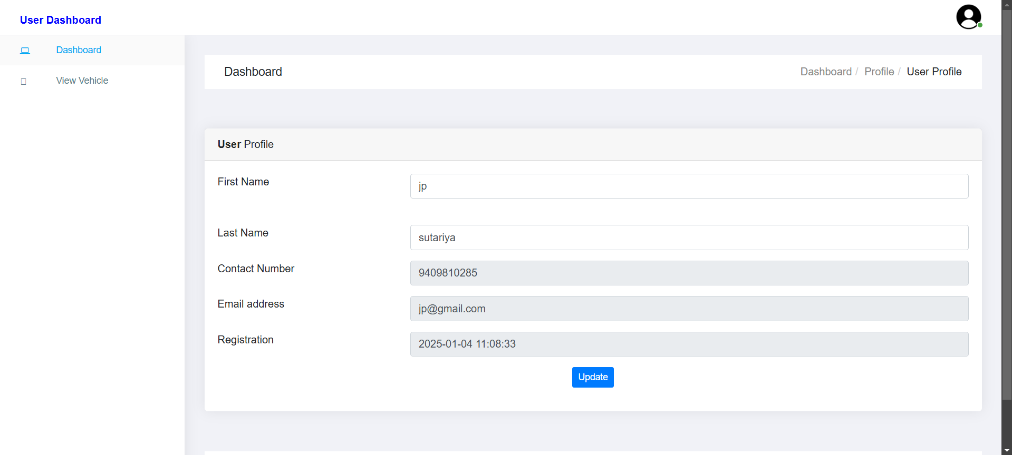
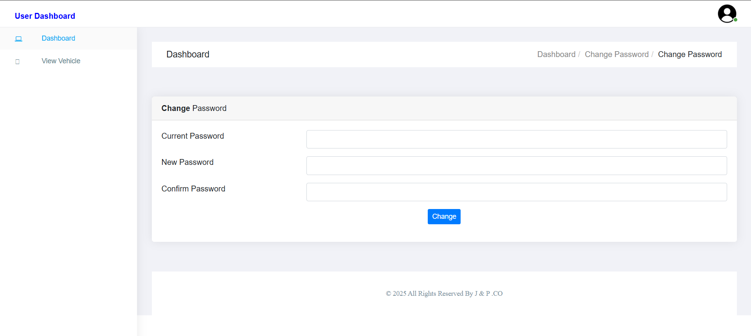
Screen Shot
ScreenShot : Admin Profile >
< ScreenShot : Admin Profile Forgot Password

Slide 38
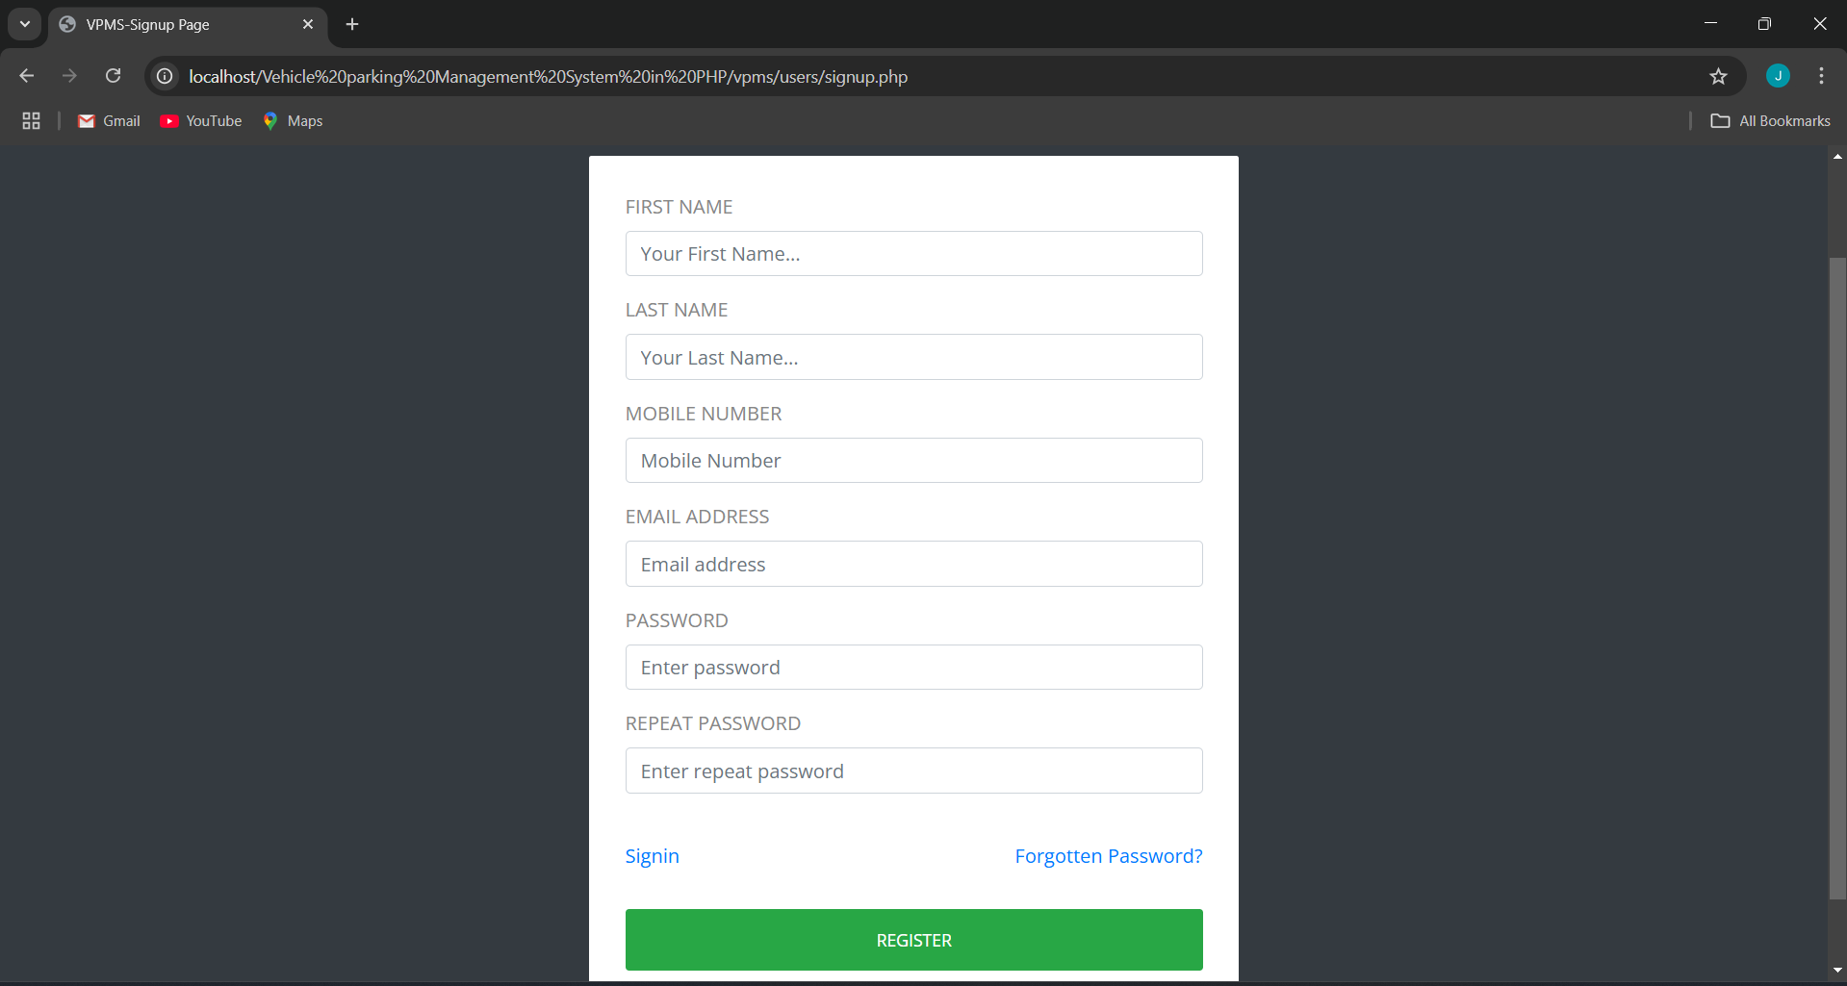
Screen Shot
ScreenShot : User Register

Slide 39
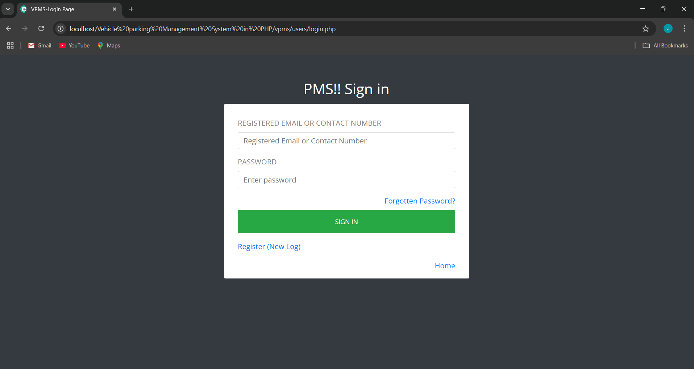
Screen Shot
ScreenShot : User Login

Slide 40
Screen Shot
ScreenShot : User Forgot Password

Slide 41
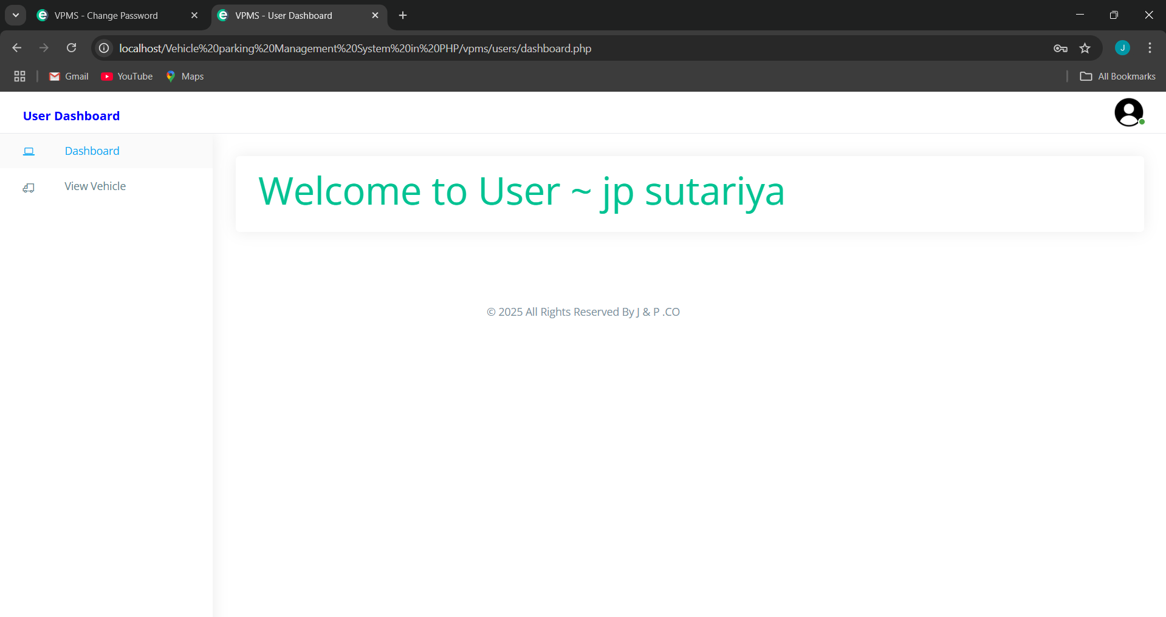
Screen Shot
ScreenShot : User Login Page

Slide 42
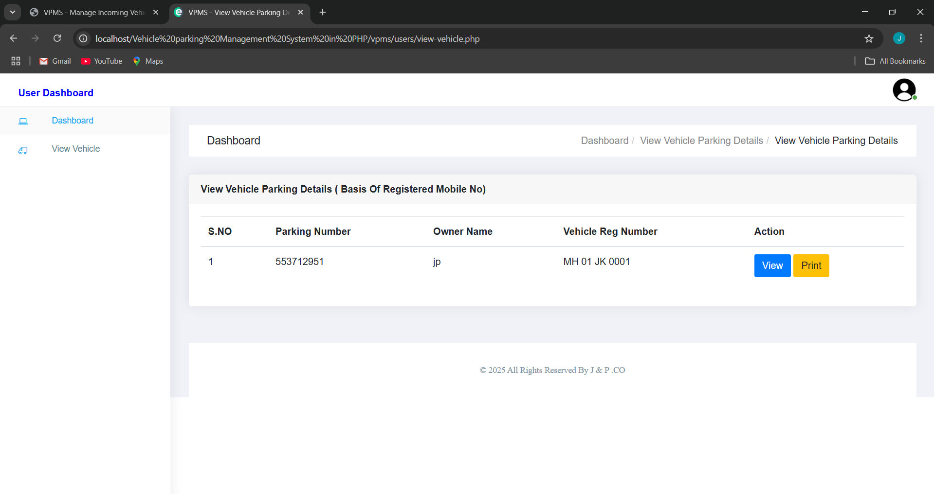
Screen Shot
ScreenShot : User Vehicle Detail

Slide 43
Screen Shot
ScreenShot : User Click Print

Slide 44
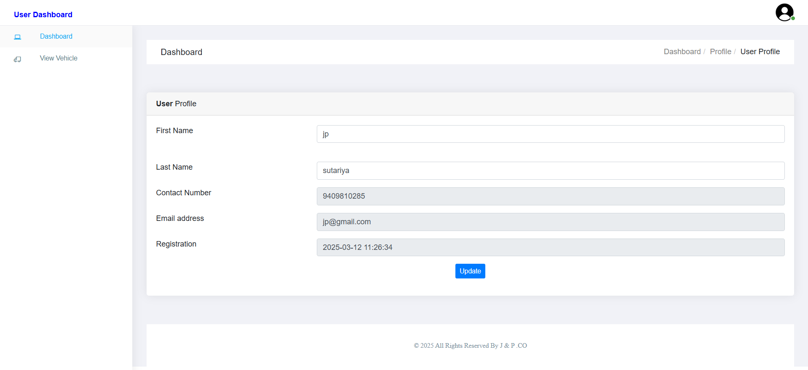
Screen Shot
ScreenShot : User Profile

Slide 45
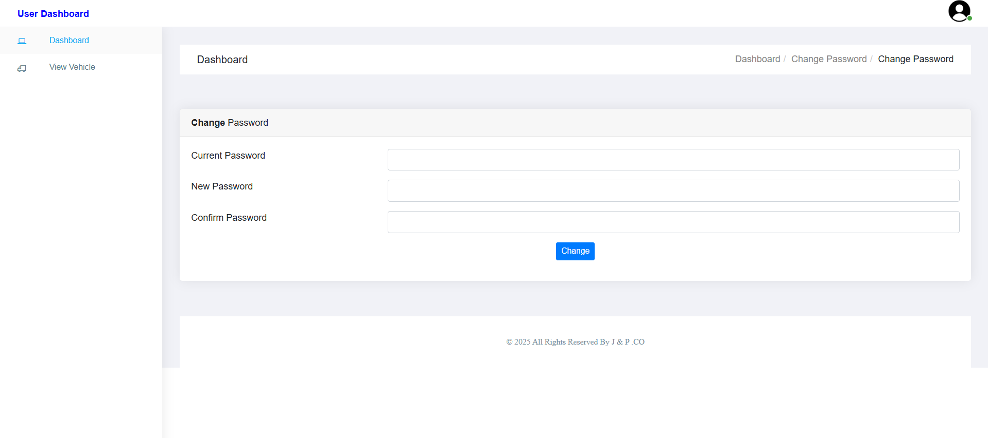
Screen Shot
ScreenShot : User Profile Change Password

Slide 46
Limitation of system
Scalability Issues: May not perform well with high vehicle volumes.
No Real-time Updates: Parking space availability isn't shown live.
No Online Payment: Lacks integrated payment gateway.
Limited User Interaction: Needs mobile app/SMS support.
Security Gaps: Lacks encryption and robust authentication.
No LPR Integration: Manual vehicle detail entry still required.
Internet Dependence: Needs constant connectivity.
Manual Maintenance: Updates and bug fixes may need technical help.

Slide 47
Future Scope of System
Mobile App Integration: Dedicated Android/iOS app for reservations, payments, directions & alerts.
Reservation & Pre-booking: Users can reserve spots in advance and receive reminders.
Automated Payment Systems: Support for cards, wallets, and contactless payments via app or kiosk.
Automatic Number Plate Recognition (ANPR): Enables seamless vehicle entry/exit without manual input.
Dynamic Pricing: Fee structure adapts based on demand, time, and availability.
EV Support: Integration of EV charging stations with live availability and payment.
Enhanced Security: Facial recognition, 2FA, and video surveillance integration.
User Feedback & Ratings: Collect reviews to improve services and customer experience.
Smart City Integration: Connects with city systems for traffic and infrastructure optimization.

Slide 48
Bibliography
W3Schools. (2025). PHP Tutorial. https://www.w3schools.com/php/
Bootstrap Official Documentation. (2025). Bootstrap Framework for Responsive Web Design. https://getbootstrap.com/
MySQL Documentation. (2025). MySQL Reference Manual. https://dev.mysql.com/doc/
PHP Manual. (2025). PHP Documentation. https://www.php.net/manual/en/

Slide 49
Thank you

